Slide 1
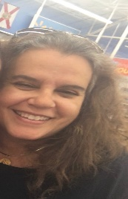
Welcome to Mrs. Prestia’s Math Class
Week #6: May 18– May 22, 2020
Objectives for the Week:
Assignment Schedule for This Week:
M: Work on incomplete Thinkcentral assignments; Help sessions available
T: I-Ready Math 20 min./Thinkcentral assignments that are incomplete
W: Complete all assignments; Help session available
R: Think Central assignments/I-Ready Math
F: All math assignments are due
Student Shout-Out:
Alexander Adams
Perfect Attendance
LIVE LESSON LEARNERS!I
Need a help session?
Email or send me a message on Remind! V
Monday-Friday
8:00 a.m. – 9:00 a.m.
Or
2:00 p.m. – 3:00 p.m.
teacher Email Address
Prestiav@leonschools.net
Send a message via Remind

